Slide 1



Bootstrap and Improve Your SDLC with OWASP SAMM - ASAP!
Event Name
Event Date

Slide 2

Notes:
Piece of cake!

Slide 3
How About You?
A little bit about you!
What is your SAMM experience?
Your role in application security?
Specific areas you’d like to cover?

Slide 4
This Training Will Cover:
SAMM 2.0
How to apply OWASP SAMM in practice
Looking into different practices from a practical perspective
Discuss some of the challenges that you might face
Open interaction session
Notes:
Maturity models provide an excellent framework for reasoning on software assurance at a strategic level.

Slide 5
Day 1 Schedule
Part One
Part Two
SDLC Overview & OWASP SAMM Introduction
The Application Security Challenge
Software Development Lifecycle (SDLC) Overview
OWASP SAMM - Vision, History, Structure
OWASP SAMM As an Assessment Tool
OWASP SAMM Tools
Tools of the Trade
SAMM Assessment Toolkit
Benchmark Project
Leveraging OWASP Projects and Tools

Slide 6
Day 2 Schedule
Part Three
Part Four
Applying OWASP SAMM
Methodology
Establishing Assessment Scope
Assessing Governance
Assessing Design
Assessing Implementation
Assessing Verification
Assessing Operations
Setting Maturity Targets & Improvement Activities
OWASP SAMM Best Practices
Choosing the Right Starting Points
Metrics and Management
Achieving Security by Design
Critical Success Factors

Slide 7
Preparation
Download the OWASP SAMM Toolbox:
https://github.com/OWASP/samm/tree/master/Supporting%20Resources/v2.0/toolbox/

Slide 8
Part One
SDLC Overview & OWASP SAMM Introduction
The Application Security Challenge Opportunity
Software Development Lifecycle (SDLC) Overview
OWASP SAMM - Vision, History, Structure
OWASP SAMM As an Assessment Tool

Slide 9
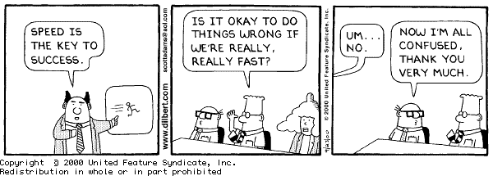
Application Security Problem
Quality (ISO 25010)
Compliance
Availability
Cost
Speed of Delivery
Technology
Risk
Integrity
Confidentiality
Cloud
Microservices
79% of vulnerabilities are application related
Notes:
we can’t slow down
we have to build it right
and we want to minimize expense on capitalized projects
79% in 2018
34.78% of vulnerabilities discovered rated as High or Critical Risk (EdgeScan)
MTTR was 50.55 days

Slide 10
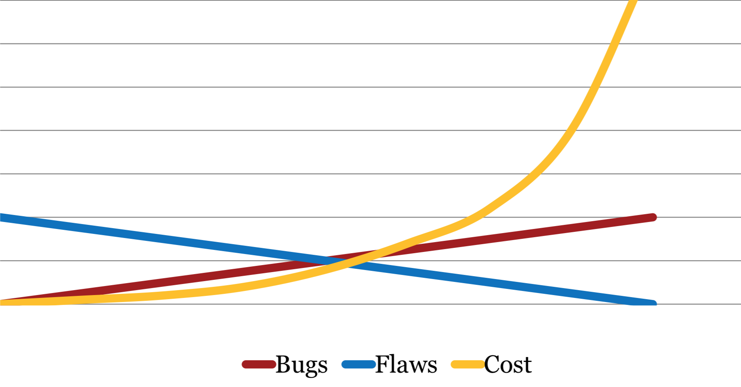
Application Security Costs
Analysis
Design
Implement
Test
Deploy
Maintain

Slide 11
“Build in” Software Assurance
Proactive
Reactive
security
requirements /
threat modeling
coding guidelines code reviews static test tools
security testing dynamic test
tools
vulnerability
scanning -
WAF
Design
Build
Test
Production
Secure Development Life Cycle
● ‹#› 

Slide 12
Part One
SDLC Overview & OWASP SAMM Introduction
The Application Security Opportunity
Software Development Lifecycle (SDLC) Overview
OWASP SAMM - Vision, History, Structure
OWASP SAMM As an Assessment Tool

Slide 13
Typical SDLC
Problematic, since:
Focus on bugs, not flaws
Not cost efficient
No security assurance
All bugs found ?
Bug-fix fixes all occurrences ? (also future ?)
Bug-fix might introduce new security vulnerabilities
Analysis
Design
Implement
Test
Deploy
Maintain
Arch review
Pentest
Patch

Slide 14
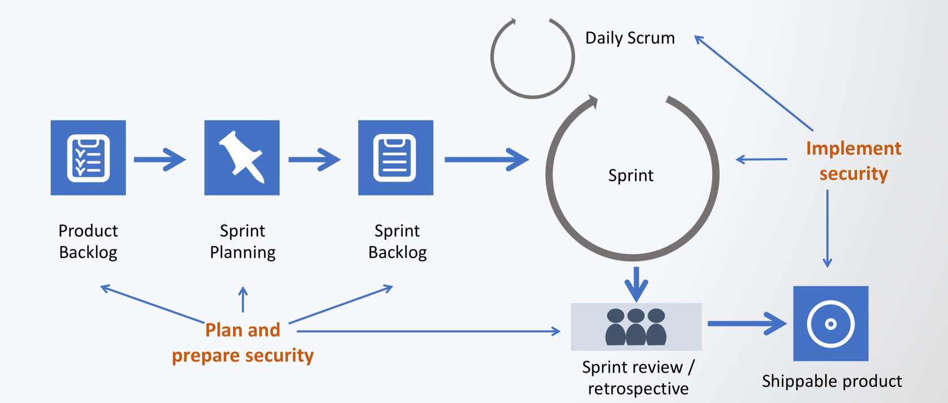
Security In Agile Scrum

Slide 15
Secure by Design
Enterprise-wide software security improvement program
Strategic approach to assure software quality
Goal is to increase systematicity
Focus on security functionality and security hygiene
Analysis
Design
Implement
Test
Deploy
Maintain
Security practiced throughout the development life-cycle
Notes:
SDLC Objective: To develop (and maintain) software in a consistent and efficient way with a demonstrable & standards-compliant security quality, inline with the organizational risks.

Slide 16
SDLC Cornerstones
People
Roles & Responsibilities
Risk
Training
Process
Activities
Deliverables
Control Gates
Knowledge
Standards & Guidelines
Compliance
Transfer methods
Tools & Components
Development support
Assessment tools
Management tools
Notes:
‹#›

Slide 17
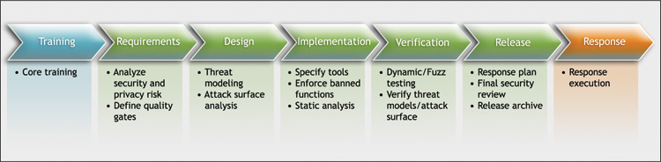


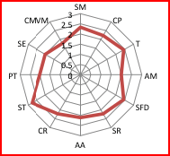


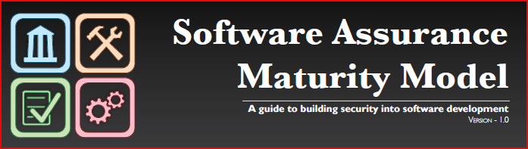
SDLC Initiatives

Slide 18
Part One
SDLC Overview & OWASP SAMM Introduction
The Application Security Opportunity
Software Development Lifecycle (SDLC) Overview
OWASP SAMM - Vision, History, Structure
OWASP SAMM As an Assessment Tool

Slide 19
SAMM principles
An organization’s behavior changes slowly over time
Changes must be iterative while working toward long-term goals
There is no single recipe that works for all organizations
A solution must enable risk-based choices tailored to the organization
Guidance related to security activities must be prescriptive
A solution must provide enough details for non-security-people
Overall, it must be simple, well-defined, and measurable
OWASP Software Assurance Maturity Model (SAMM)

Slide 20

Why SAMM?
"The most that can be expected from any model is that it can supply a useful approximation to reality. All models are wrong; some models are useful."
George E. P. Box
Notes:
Other process models exist, with their pro’s and con’s
In general, no process will fit your organization perfectly
Mix-and-Match + adaptation are necessary

Slide 21
Project History
OpenSAMM 1.0
Release: March 25 2009
OWASP SAMM 1.1
Release: March 2016
OWASP SAMM 2.0 Beta Release: January 2019
2015
2017
2020
2009
2016
2019
OpenSAMM 1.1
Release: December 2015
OWASP SAMM 1.5
Release: February 2017
OWASP SAMM 2.0
Release: January 2020

Slide 22



What is SAMM?
Measurable
Defined maturity levels across business practices
Actionable
Clear pathways for improving maturity levels
Versatile
Technology, process, and organization agnostic
The Software Assurance Maturity Model (SAMM) is an open framework that provides an effective and measurable way for all types of organizations to analyze and improve their software security posture.
owaspsamm.org

Slide 23
What is SAMM?
The resources provided by SAMM aid in
evaluating an organization’s existing software security practices
building a balanced software security assurance program in well-defined iterations
demonstrating concrete improvements to a security assurance program
defining and measuring security-related activities throughout an organization

Slide 24
SAMM versions 1.5 and 2.0
Business functions (4 in SAMM 1.5, 5 in SAMM 2.0)
3 security practices for each business function
The security practices cover areas relevant to software security assurance

Slide 25




Who is SAMM today?
Sebastien (Seba) Deleersnyder
Project Co-Leader, Belgium
Brian Glas – United States
Daniel Kefer – Germany
Yan Kravchenko – United States
Chris Cooper – United Kingdom
John DiLeo – New Zealand
Nessim Kisserli – Belgium
Bart De Win
Project Co-Leader, Belgium
Patricia Duarte – Uruguay
John Kennedy – Sweden
Hardik Parekh - United States
John Ellingsworth - United States
Sebastian Arriada - Argentina
Brett Crawley – United Kingdom
Sponsors:

Slide 26
OWASP SAMM Structure
Business Functions
Security Practices
Stream 1
Stream 2
Maturity Level I
Activities
Maturity Level I
Activities
Maturity Level II
Activities
Maturity Level II
Activities
Maturity Level III
Activities
Maturity Level III
Activities

Slide 27
SAMM Business Functions
Start with the core activities tied to any organization performing software development
Named generically, but should resonate with any development stakeholder
Governance
Design
Implementation
Verification
Operations

Slide 28
SAMM Security Practices
From each of the Business Functions, 3 Security Practices are defined
The Security Practices cover all areas relevant to software security assurance
Each one an ‘silo’ for improvement
Governance
Design
Implementation
Verification
Operations
Strategy & Metrics
Policy & Compliance
Education & Guidance
Threat Assessment
Security Requirements
Security Architecture
Secure Build
Secure Deployment
Defect Management
Architecture Assessment
Requirements Testing
Security Testing
Incident Management
Environment Management
Operational Management

Slide 29
Under Each Security Practice
Three successive Objectives under each Practice define how it can be improved over time
This establishes a notion of a Level at which an organization fulfills a given Practice
The three Levels for a Practice generally correspond to:
(0: Implicit starting point with the Practice unfulfilled)
1: Initial understanding and ad hoc provision of the Practice
2: Increase efficiency and/or effectiveness of the Practice
3: Comprehensive mastery of the Practice at scale

Slide 30
Activity Streams & Maturity Level
 | A: Control Verification | B: Misuse/Abuse Testing
Maturity 1 - Opportunistically find basic vulnerabilities and other security issues. | Test for standard security controls | Perform security fuzzing testing
Maturity 2 - Perform implementation review to discover application-specific risks against the security requirements. | Derive test cases from known security requirements | Create and test abuse cases and business logic flaw test
Maturity 3 - Maintain the application security level after bug fixes, changes or during maintenance | Perform regression testing (with security unit tests) | Denial of service and security stress testing
Streams
Maturity
Activities
This security practice focuses on creating and integrating both positive (Control Verification) and negative (Misuse/Abuse Testing) security tests based on requirements (user stories).

Slide 31
Maturity levels and scoring
Transparent view over different levels
Fine-grained improvements are visible
Maturity levels |  | Assessment scores
3 | Comprehensive mastery at scale | 1 | Most
2 | Increased efficiency and effectiveness | 0.5 | At least half
1 | Ad-hoc provision | 0.2 | Some
0 | Practice unfulfilled | 0 | None

Slide 32
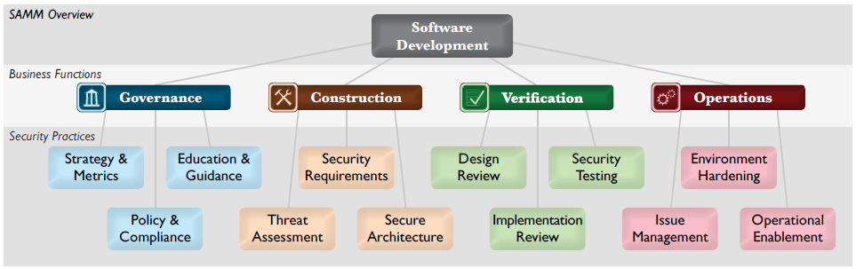
SAMM Core Framework v1.5
For each of the four Business Functions, three Security Practices are defined
The security practices encompass activities relevant to software security assurance

Slide 33
SAMM Core Framework v2.0
Governance
Design
Implementation
Verification
Operations
Strategy &
Metrics
Threat
Assessment
Secure Build
Architecture Assessment
Incident Management
Policy & Compliance
Security Requirements
Secure Deployment
Requirements-
driven Testing
Environment Management
Education & Guidance
Secure Architecture
Defect Management
Security Testing
Operational Management
Notes:
For each of the five Business Functions, three Security Practices are defined
The security practices encompass activities relevant to application security assurance

Slide 34
SAMM Core Framework v2.0
Governance
Design
Implementation
Verification
Operations
Strategy &
Metrics
Threat
Assessment
Secure Build
Architecture Assessment
Incident Management
Policy & Compliance
Security Requirements
Secure Deployment
Requirements-
driven Testing
Environment Management
Education & Guidance
Secure Architecture
Defect Management
Security Testing
Operational Management

Slide 35
Governance
Design
Implementation
Verification
Operations
Strategy &
Metrics
Threat
Assessment
Secure Build
Architecture Assessment
Incident Management
Create & promote
Measure & improve
App risk profile
Threat model
Build process
Dependencies
Architecture validation
Architecture compliance
Incident detection
Incident response
Policy & Compliance
Security Requirements
Secure Deployment
Requirements-
driven Testing
Environment Management
Policy & standards
Compliance mgmt
Software reqmts
Supplier security
Deployment process
Secret mgmt
Control verification
Misuse/abuse testing
Config hardening
Patch & update
Education & Guidance
Secure Architecture
Defect Management
Security Testing
Operational Management
Security Architecture
Training & awareness
Org & culture
Architecture design
Technology mgmt
Defect tracking
Metrics & feedback
Scalable baseline
Deep understanding
Data protection
Legacy mgmt
Stream A
Stream B
Stream A
Stream B
Stream A
Stream B
Stream A
Stream B
Stream A
Stream B

Slide 36
Governance
Design
Implementation
Verification
Operations
Strategy &
Metrics
Threat
Assessment
Secure Build
Architecture Assessment
Incident Management
Create & promote
Measure & improve
App risk profile
Threat model
Build process
Dependencies
Architecture validation
Architecture compliance
Incident detection
Incident response
Policy & Compliance
Security Requirements
Secure Deployment
Requirements-
driven Testing
Environment Management
Policy & standards
Compliance mgmt
Software reqmts
Supplier security
Deployment process
Secret mgmt
Control verification
Misuse/abuse testing
Config hardening
Patch & update
Education & Guidance
Secure Architecture
Defect Management
Security Testing
Operational Management
Security Architecture
Training & awareness
Org & culture
Architecture design
Technology mgmt
Defect tracking
Metrics & feedback
Scalable baseline
Deep understanding
Data protection
Legacy mgmt
Stream A
Stream B
Stream A
Stream B
Stream A
Stream B
Stream A
Stream B
Stream A
Stream B

Slide 37
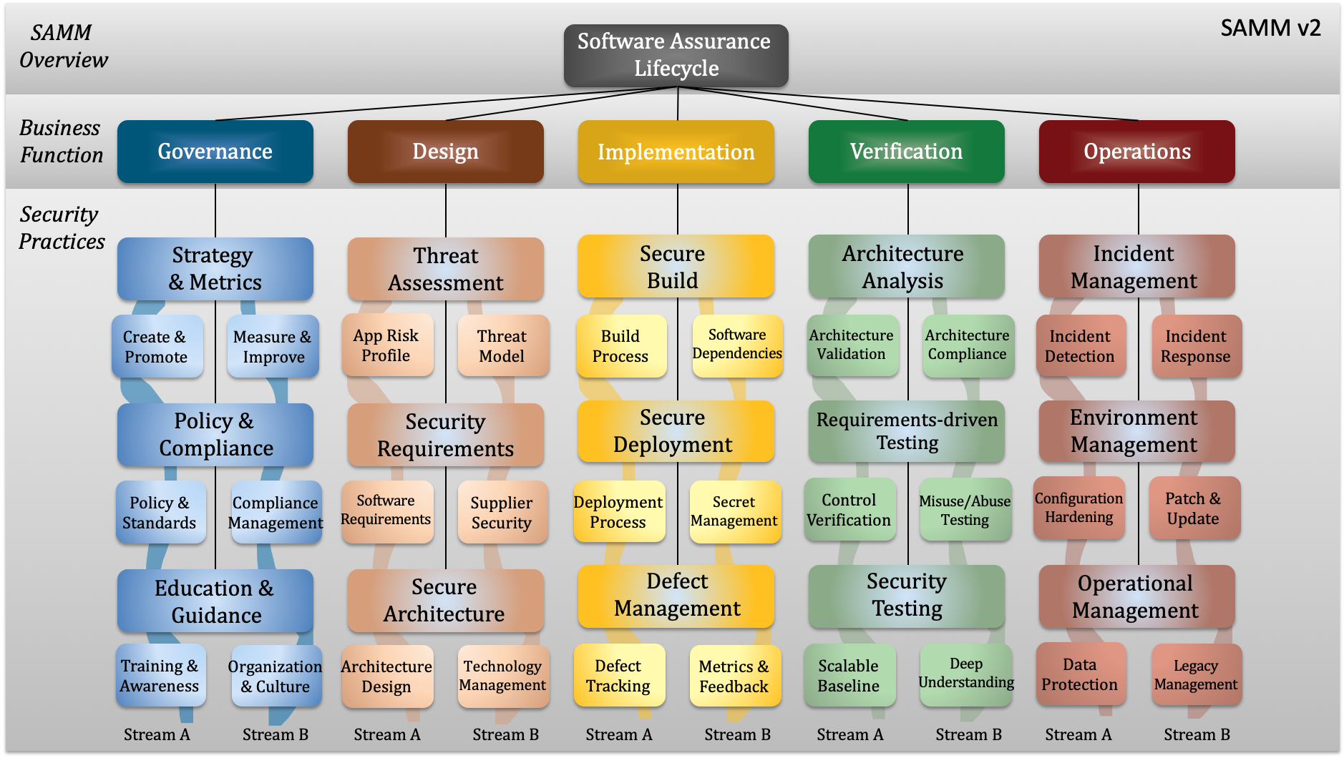

Slide 38
Key Changes in SAMM v2.0
SAMM v2.0
Five Business Functions - Governance, Design, Implementation, Verification, Operations
15 Security Practices
New Business Function "Implementation" to accommodate guidance related to build and deploy domains
Maturity level activities are aligned and linked per Stream. Each stream has a clear Objective
Maturity level activities designed in order of increasing difficulty, implementation cost
Coverage & Quality based measurement
SAMM v1.5
Four Business Functions - Governance, Construction, Verification, Operations
12 Security Practices
Very little, if any, prescriptive guidance for build and deploy domains
Maturity level activities could be orphaned, and sometimes unrelated to each other
Maturity level activities not in order of increasing difficulty, cost of implementation
Coverage based measurement

Slide 39
Part One
SDLC Overview & OWASP SAMM Introduction
The ‘Application Security Problem’
Software Development Lifecycle (SDLC) Overview
OWASP SAMM - Vision, History, Structure
OWASP SAMM As an Assessment Tool

Slide 40

Applying the Assessment

Slide 41








Maturity Assessment Levels
Comprehensive mastery at scale
Many/Most
Increased efficiency/effectiveness
At Least Half
Few/Some
Ad-hoc provision
No
Practice unfulfilled
Transparent view over different levels
Fine-grained improvements are visible

Slide 42
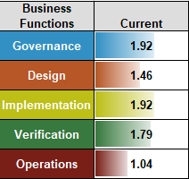
Assessment Process
Assess activities along two axes:
Coverage, by means of questions
Quality, by means of mandatory criteria

Slide 43
Maturity Score = Sum(Avg(StreamALevel1,StreamBLevel1)+Avg(StreamALevel2,StreamBLevel2)+Avg(StreamALevel3,StreamBLevel3))
Stream | Level | Requirements Testing |  | Answer
A: Control Verification | 1 | Do you test applications for the correct functioning of standard security controls? |  | Yes, the majority of them | 1 | 0.750
 | QC: | Security testing at least verifies the implementation of authentication, access control, input validation, encoding and escaping data, and encryption controls.
 | QC: | Security testing executes whenever the application changes its use of the controls.
 | 2 | Do you test security controls based on the specific application security requirements? |  | Yes, some of them | 0.2 | 0.200
 | QC: | Tests are tailored to each application and assert expected security functionality.
 | QC: | Test results are captured as a pass or fail condition
 | 3 | Do you automatically test applications for security regressions? |  | No | 0 | 0.000
 | QC: | Tests are consistently written for all identified bugs (possibly exceeding a pre-defined severity threshhold)
 | QC: | Security tests are collected in a test suite that is part of the existing unit testing framework
B: Misuse/Abuse Testing | 1 | Do you test applications using randomization techniques? |  | Yes, at least half of them | 0.5
 | QC: | Testing covers most or all of the application's main input parameters
 | QC: | All application crashes are recorded and systematically inspected for security impact
 | 2 | Do you create abuse cases from functional requirements and use them to drive security tests? |  | Yes, sometimes | 0.2
 | QC: | Important business functionality has corresponding abuse cases
 | QC: | You build abuse stories around relevant personas with well-defined motivations and characteristics
 | QC: | You capture identified weaknesses as security requirements
 | 3 | Do you perform denial of service and security stress testing? |  | No | 0
 | QC: | Stress tests target specific application resources (e.g. memory exhaustion by saving large amounts of data to a user session)
 | QC: | You design tests around relevant personas with well-defined capabilities (knowledge, resources)
Rating
0.95

Slide 44
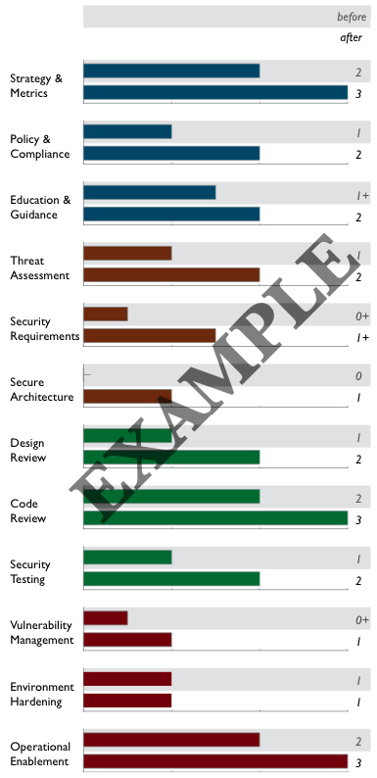
Creating Scorecards
Gap analysis
Capturing scores from detailed assessments versus expected performance levels
Demonstrating improvement
Capturing scores from before and after an iteration of assurance program build-out
Ongoing measurement
Capturing scores over consistent timeframe for an assurance program already in place

Slide 45
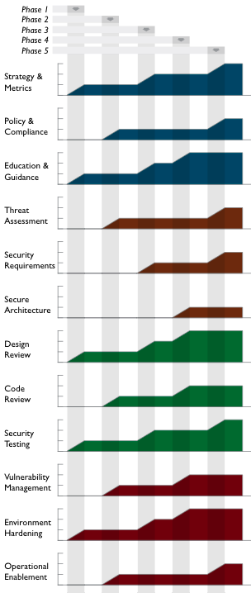
Roadmap Templates
To make the “building blocks” usable, SAMM defines Roadmap templates for typical kinds of organizations
Independent Software Vendors
Online Service Providers
Financial Services Organizations
Government Organizations
Organization types chosen because
They represent common use-cases
Each organization has variations in typical software-induced risk
Optimal creation of an assurance program is unique

Slide 46
Part Two
OWASP SAMM Tools
Tools of the Trade
SAMM Assessment Toolkit
Benchmark Project
Leveraging OWASP Projects & Tools

Slide 47
OWASP SAMM Tools
Translations (Spanish, Japanese, German, Ukrainian, …)
Assessment questionnaire(s)
Roadmap chart template
Project plan template
OWASP SAMM-BSIMM mapping
Benchmark Project
Mappings to security standards
ISO/IEC 27034, PCI, etc.
OWASP SAMM Assessment Toolbox

Slide 48
Tools of the trade
SAMM 2.0 Calculator by Concord USA
SAMM 2.0 Dashboard by SathIsh AshwIn
OWASP Maturity Models
OWASP SAMM Toolkit - GDocs version
OWASP SAMM Assessment - Google Forms & Data Studio
OWASP SAMM Toolkit - MS Excel

Slide 49
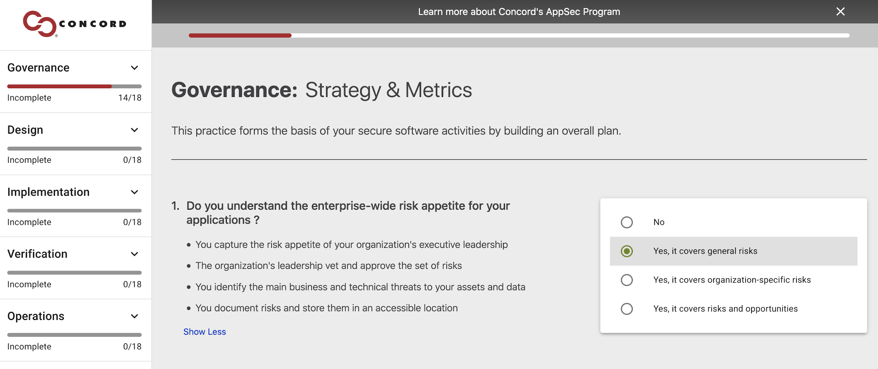
SAMM 2.0 Calculator: ConcordUSA
Components:
Self-guided assessment
Function/Practice Breakdown
Function Maturity Breakdown
SaaS Web-Based Tool
Progress Bar
Industry Benchmark Comparison
Ready to use!
https://concordusa.com/SAMM/

Slide 50
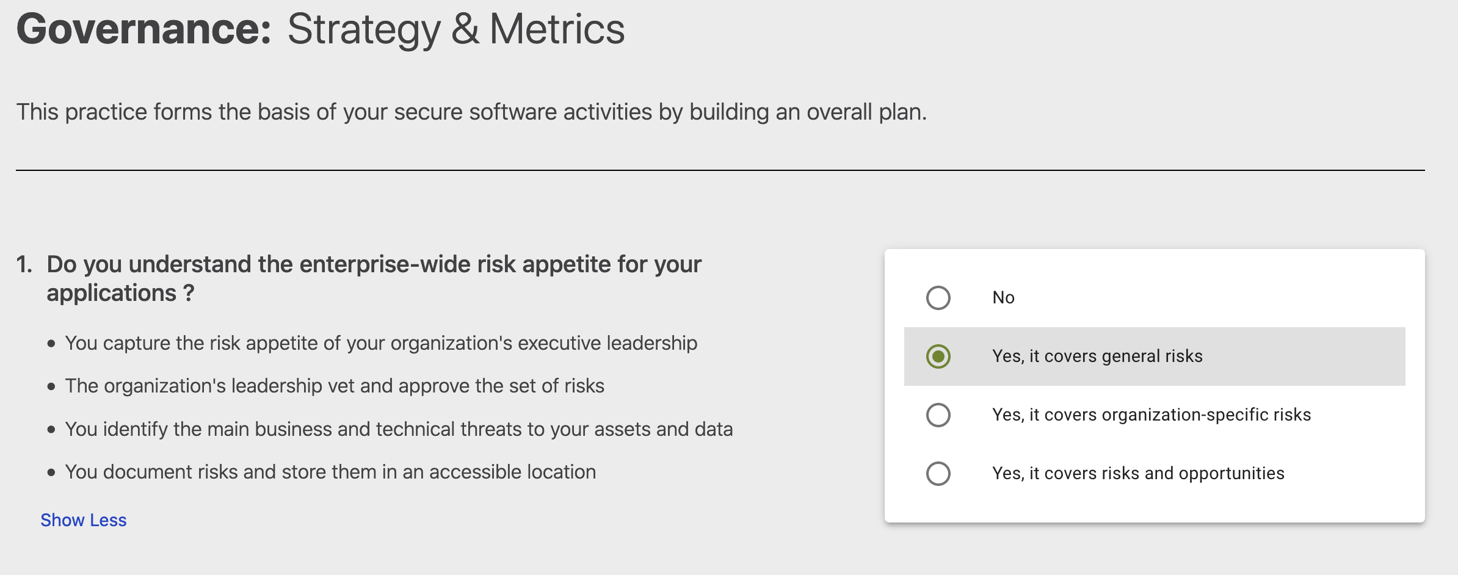
SAMM 2.0 Calculator: ConcordUSA
https://concordusa.com/SAMM/

Slide 51
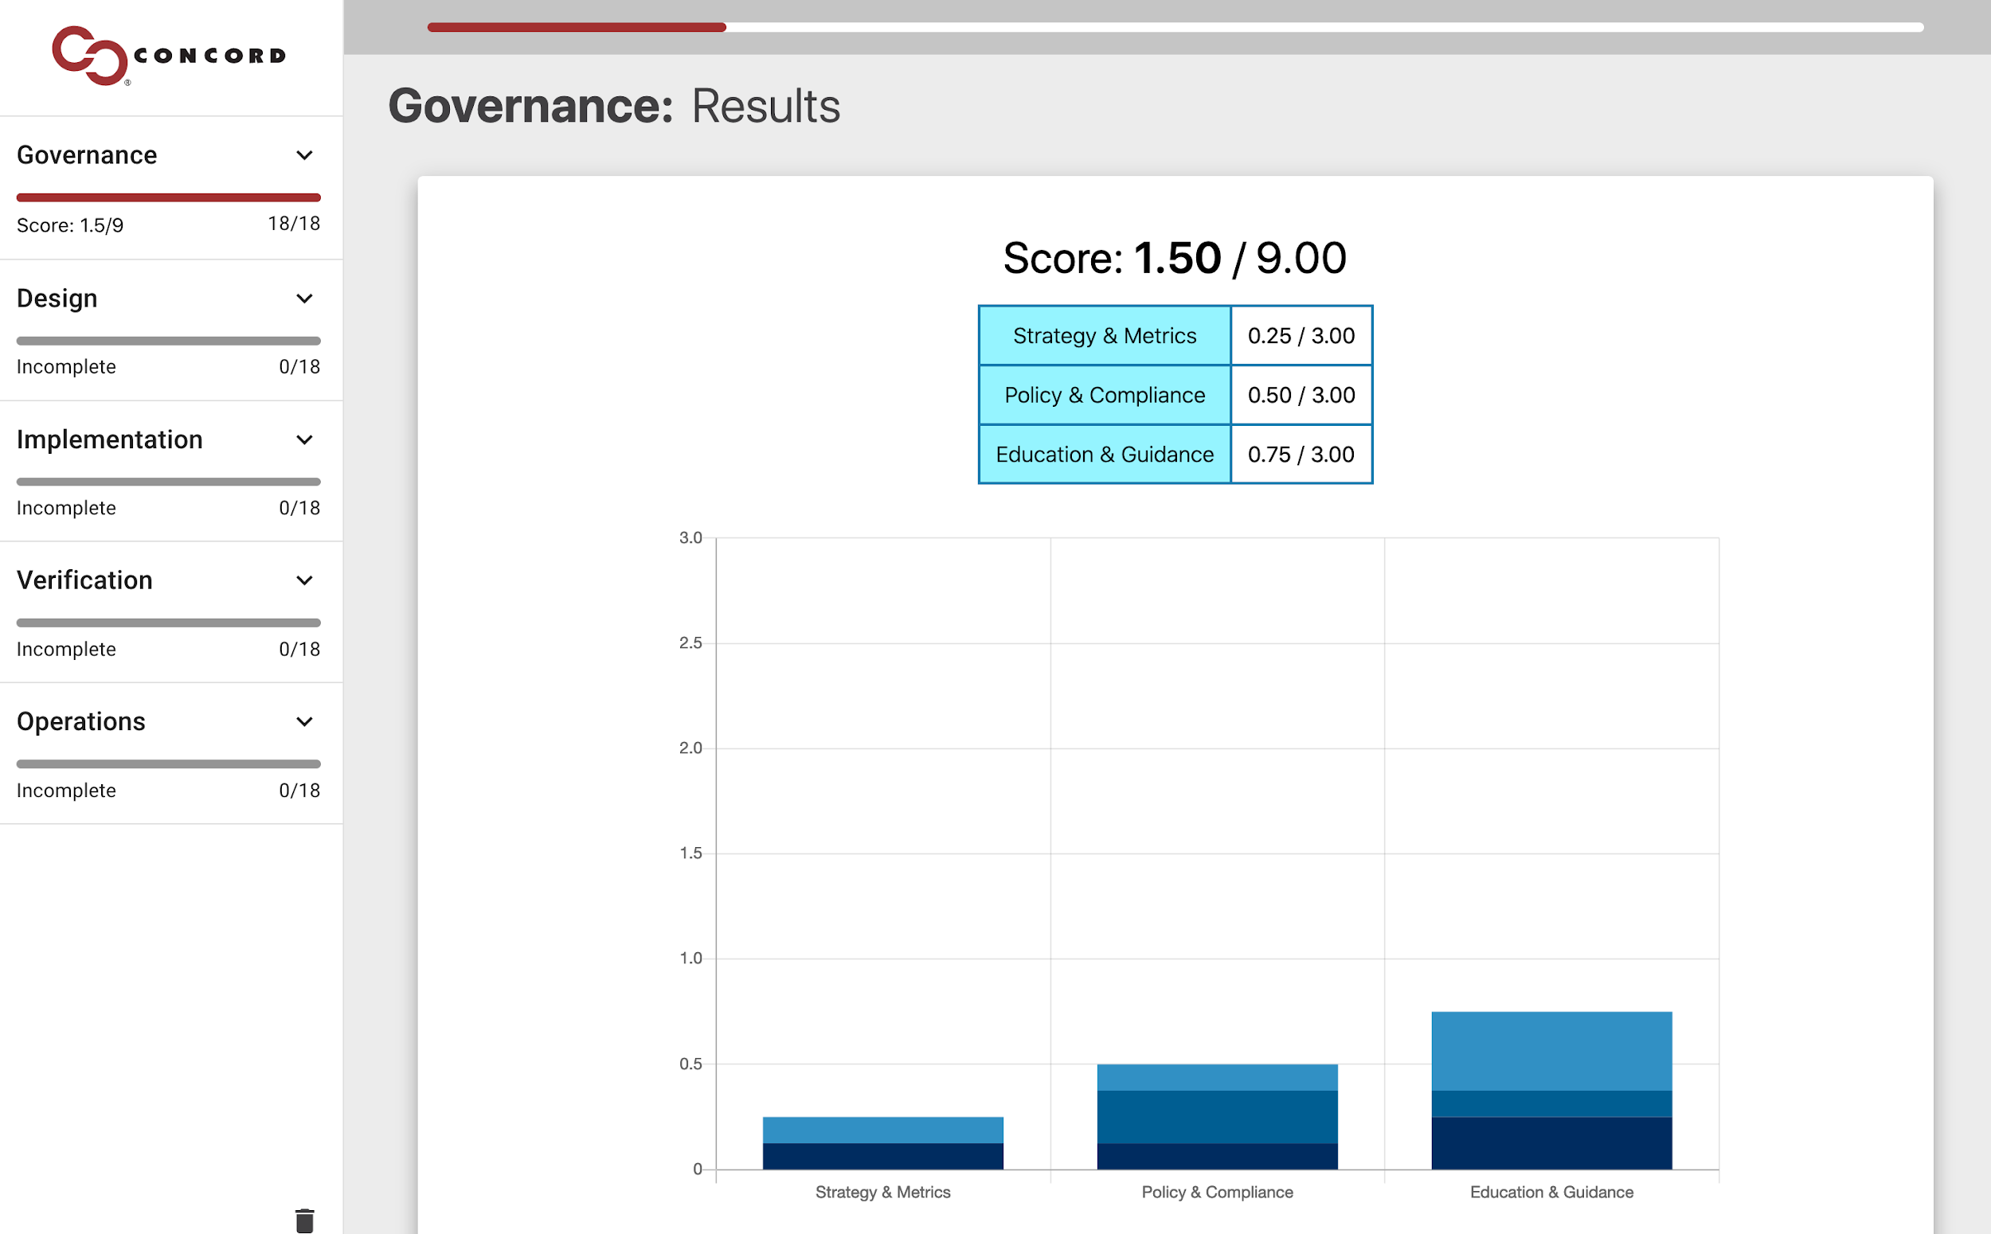
SAMM 2.0 Calculator: ConcordUSA
https://concordusa.com/SAMM/

Slide 52
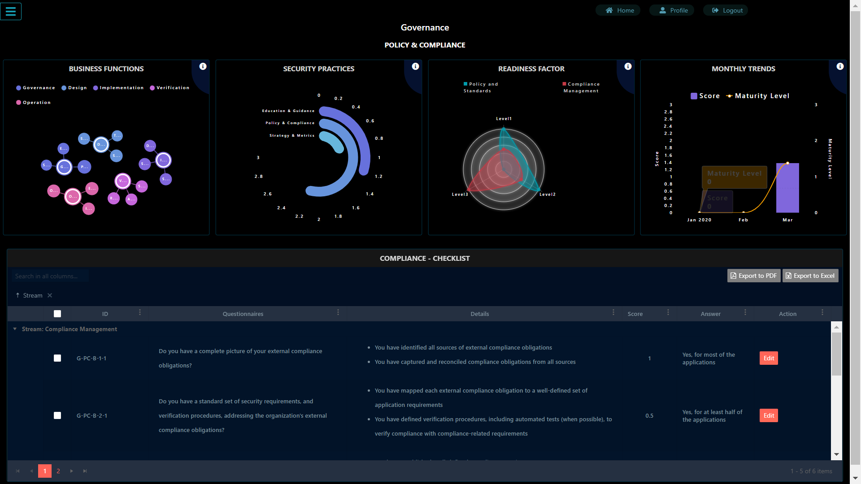
SAMM 2.0 Dashboard
Components:
Authenticated App
Role Based Access Control
Practice Trending
Angular project on Github
PDF/Excel Report Generation
Self-Hosted Solution
Ready to use!
https://github.com/OWASP/samm/tree/master/Supporting%20Resources/app

Slide 53
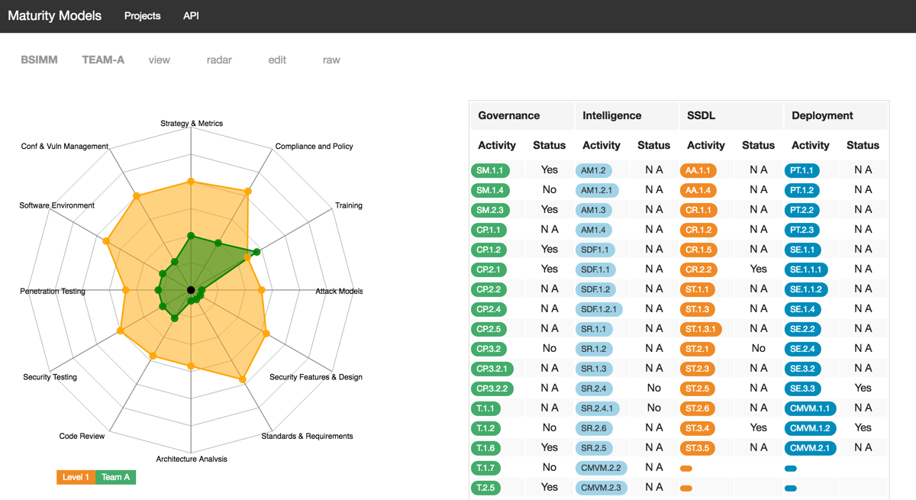
OWASP Maturity Models
Node project on Github
BSIMM focus with future support for OWASP SAMM
Self-Hosted Solution
https://github.com/owasp/Maturity-Models

Slide 54
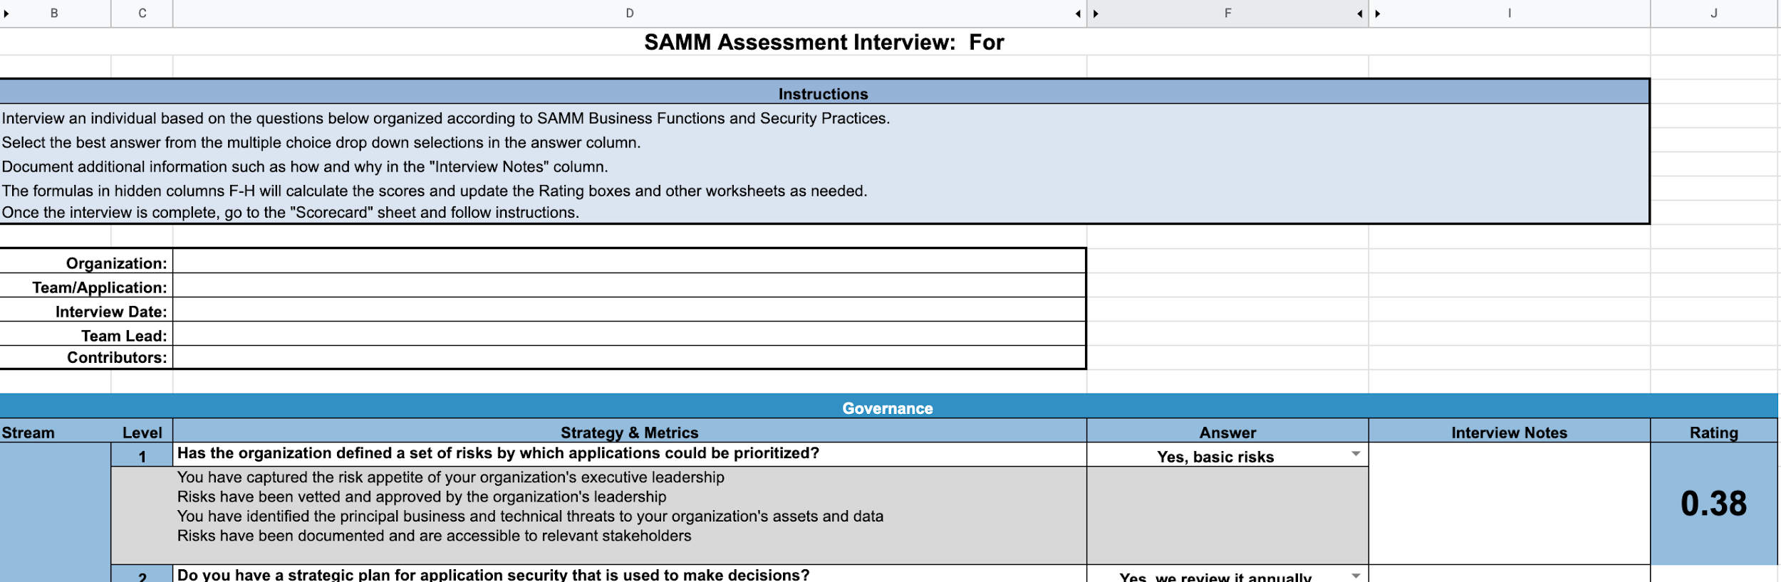
Google Sheets
Google Sheets Version of Excel Toolkit
Can be exported to reporting tools and shared with others
Currently being validated!
https://docs.google.com/spreadsheets/d/1uBoiaHcY3UpdZim1zGuKkVwSxhmCHCnaq5nawnfglsY/edit?usp=sharing

Slide 55
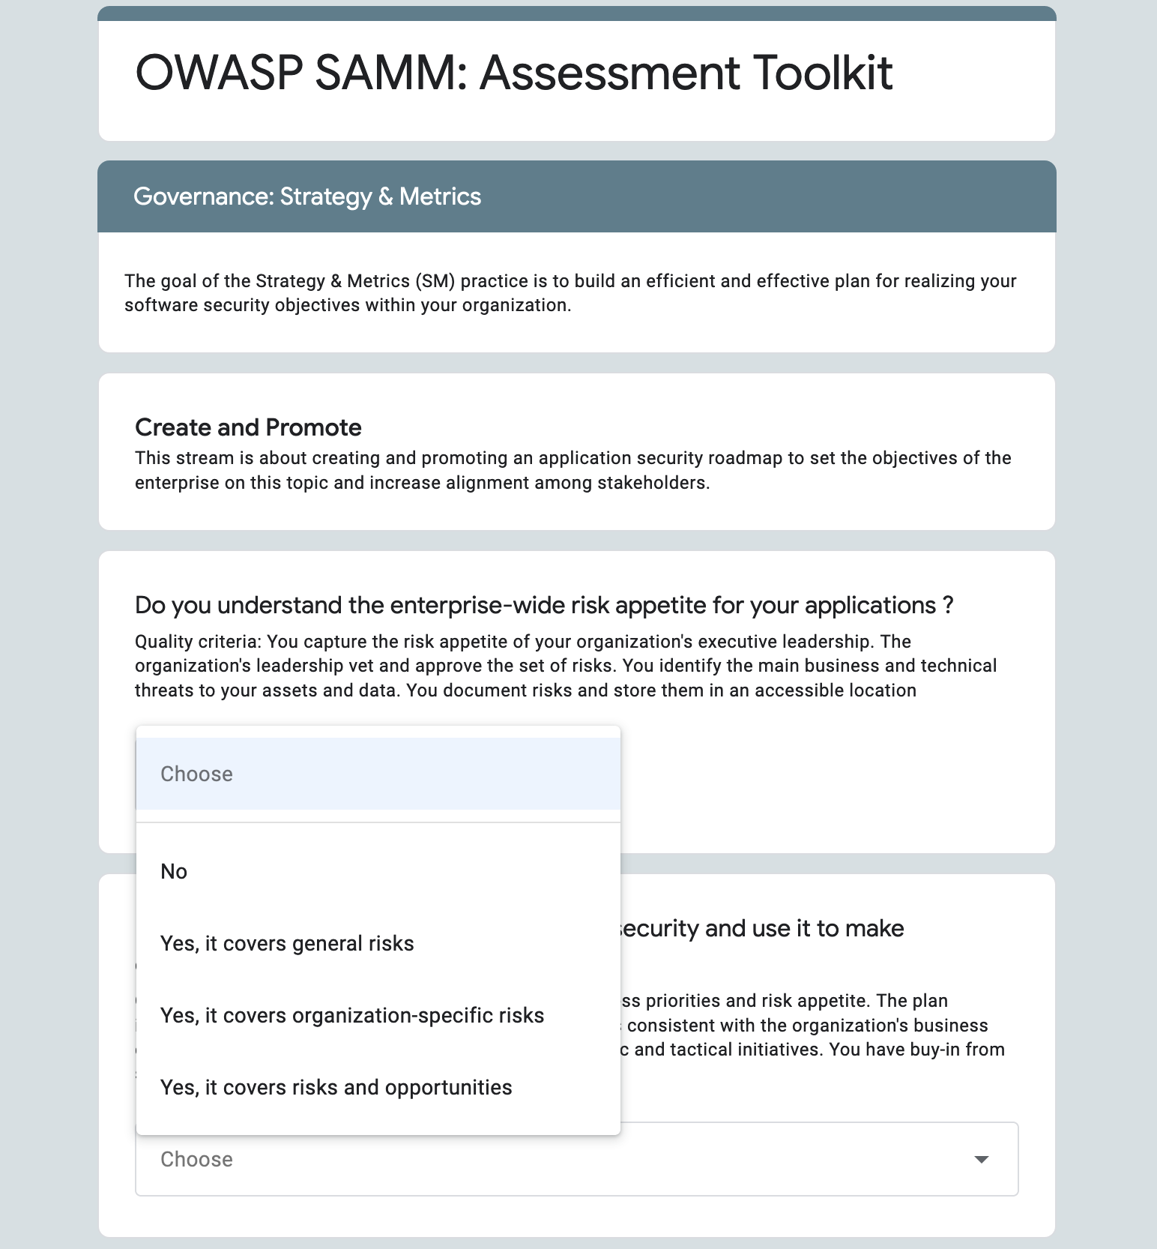
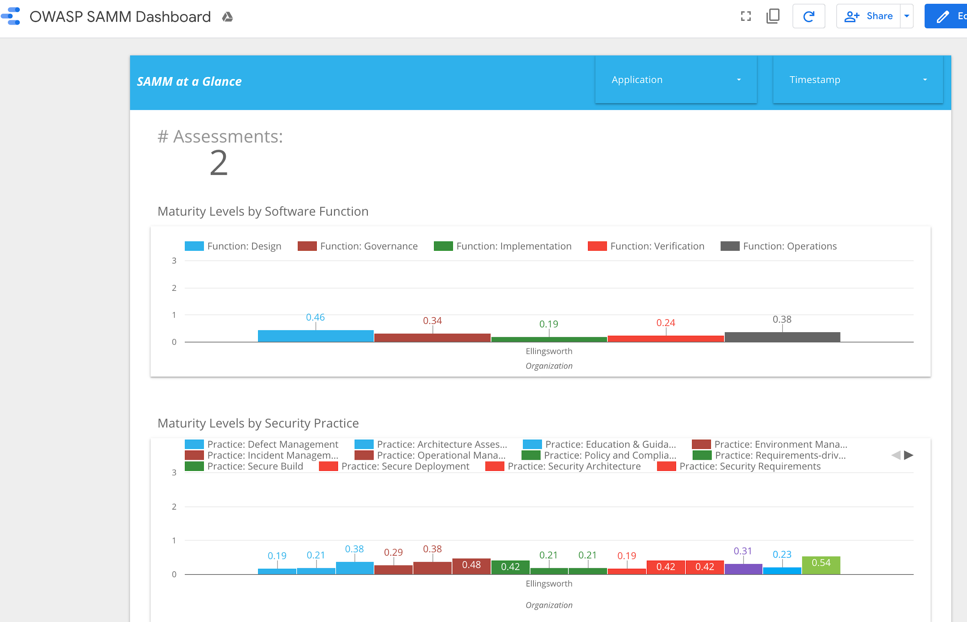
Google Forms & Data Studio
Google Sheets/Forms based assessment
Data is stored in Google Sheets
Easy Self-service Form
Responses can be edited
Can be exported to reporting tools
Google Data Studio
Currently being validated!
https://forms.gle/ufT6N79WFtoh2Bj66
https://datastudio.google.com/open/1R8vQxl13O6Qb42U-BOIMNLGRHIfR9qHA?usp=sharing

Slide 56
Part Two
OWASP SAMM Tools
Tools of the Trade
SAMM Assessment Toolkit
Benchmark Project
Leveraging OWASP Projects & Tools

Slide 57
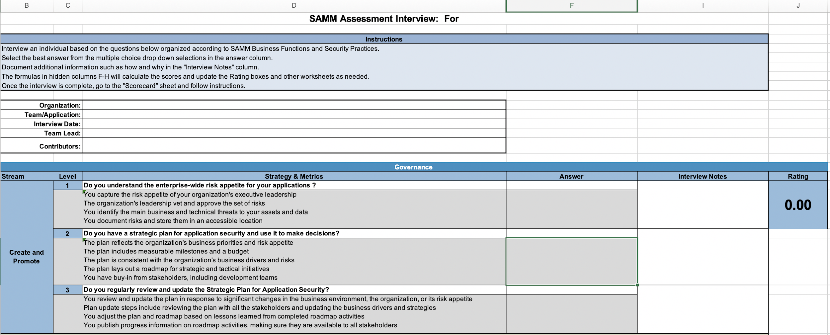
OWASP SAMM Toolkit - MS Excel
Features:
Interview Template
Assessment Questions (90)
Quality Criteria
Visual Maturity Scorecard
Roadmap Phase Planner
Roadmap Chart
Maturity Rating Calculator
Ready to use!

Slide 58
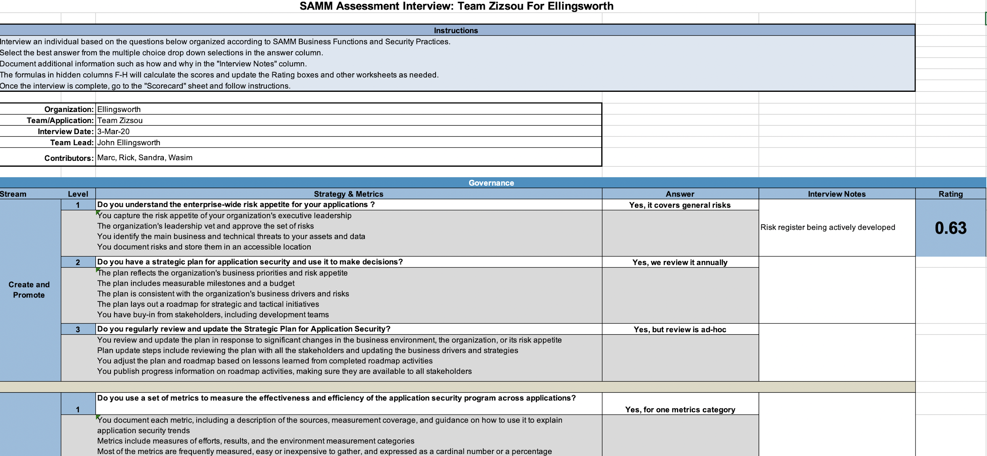
OWASP SAMM Toolkit - MS Excel
https://github.com/OWASP/samm/tree/master/Supporting%20Resources/v2.0/toolbox

Slide 59
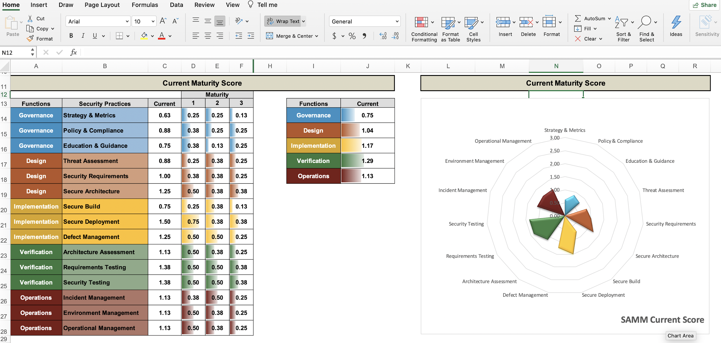
OWASP SAMM Toolkit - MS Excel
https://github.com/OWASP/samm/tree/master/Supporting%20Resources/v2.0/toolbox

Slide 60
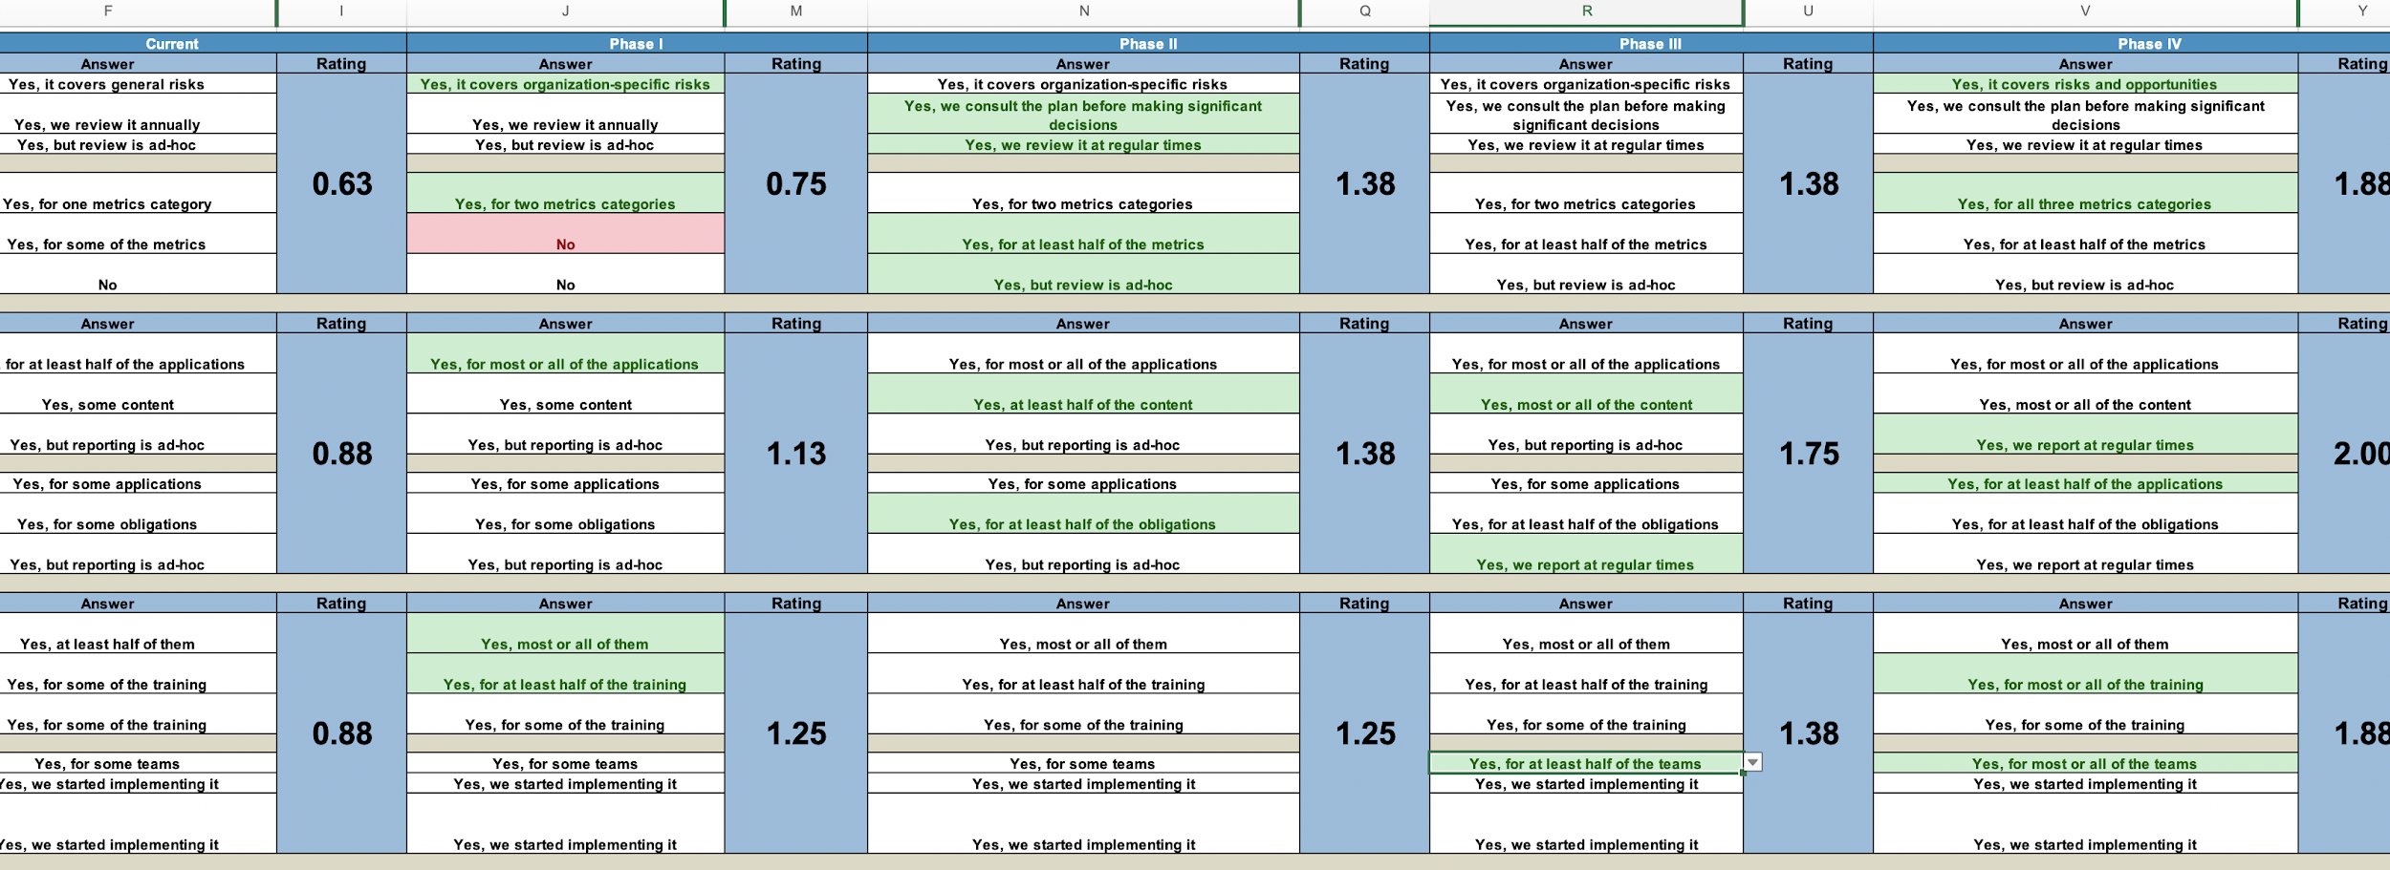
OWASP SAMM Toolkit - MS Excel
https://github.com/OWASP/samm/tree/master/Supporting%20Resources/v2.0/toolbox

Slide 61
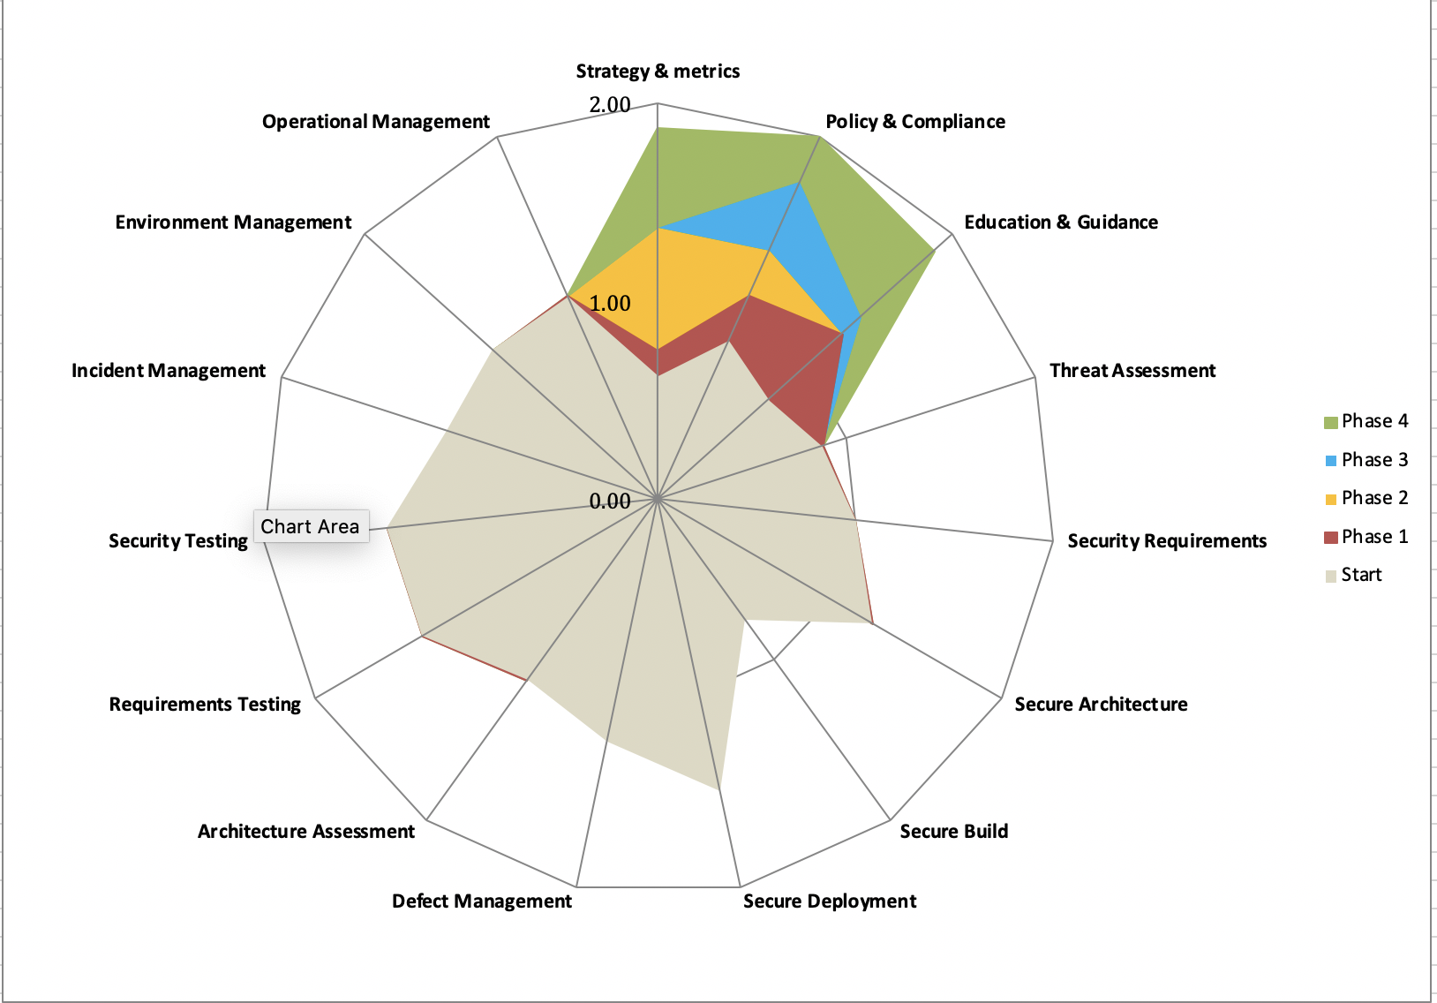
OWASP SAMM Toolkit - MS Excel
https://github.com/OWASP/samm/tree/master/Supporting%20Resources/v2.0/toolbox

Slide 62
Part Two
OWASP SAMM Tools
Tools of the Trade
SAMM Assessment Toolkit
Benchmark Project
Leveraging OWASP Projects & Tools

Slide 63
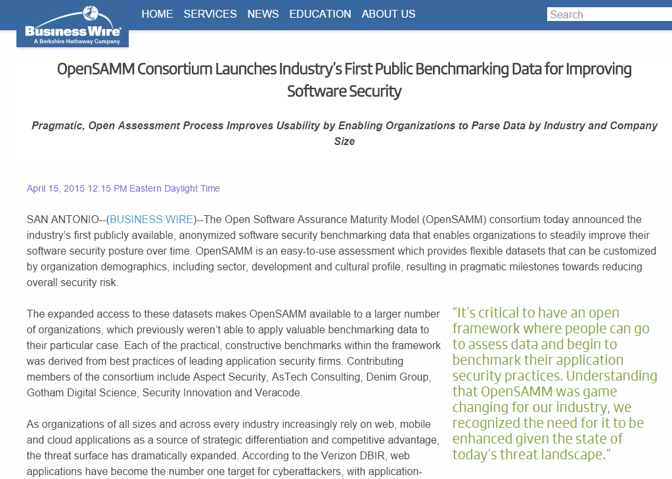
Benchmark Project

Slide 64
OWASP SAMM Benchmark Project
Overview
An open model for security benchmarking
Consortium of security companies working together
Confidentiality maintained between client & security company
Public data anonymized for benchmarking between teams, organizations

Slide 65
OWASP SAMM Benchmark Project
Benefits
Validate transformation plans
Supporting existing plans
Clients of various security companies can utilize platform
Find specific maturities in teams and organizations with varying granularity
Bring security maturity testing to the masses

Slide 66
Data contributions
Verified data contribution
the submitter is known and has agreed to be identified as a contributing party
the submitter is known but would rather not be publicly identified
the submitter is known but does not want it recorded in the dataset
Unverified data contribution
the submitter is anonymous

Slide 67
Part Two
OWASP SAMM Tools
Tools of the Trade
SAMM Assessment Toolkit
Benchmark Project
Leveraging OWASP Projects & Tools

Slide 68
150+ OWASP Projects
PROTECT
Tools: AntiSamy Java/:NET, Enterprise Security API (ESAPI), ModSecurity Core Rule Set Project
Docs: Development Guide, .NET, Ruby on Rails Security Guide, Secure Coding Practices - Quick Reference Guide
DETECT
Tools: JBroFuzz, Lice CD, WebScarab, Zed Attack Proxy
Docs: Application Security Verification Standard, Code Review Guide, Testing Guide, Top Ten Project
LIFE CYCLE
SAMM, WebGoat, Legal Project

Slide 69
Day 2 Schedule
Part Three
Part Four
Applying OWASP SAMM
Methodology
Establishing Assessment Scope
Assessing Governance
Assessing Design
Assessing Implementation
Assessing Verification
Assessing Operations
Setting Maturity Targets & Improvement Activities
OWASP SAMM Best Practices
Choosing the Right Starting Points
Metrics and Management
Achieving Security by Design
Critical Success Factors

Slide 70
Day 1 Recap
Part One
Part Two
SDLC Overview & OWASP SAMM Introduction
The Application Security Challenge
Software Development Lifecycle (SDLC) Overview
OWASP SAMM - Vision, History, Structure
OWASP SAMM As an Assessment Tool
OWASP SAMM Tools
Tools of the Trade
SAMM Assessment Toolkit
Benchmark Project
Leveraging OWASP Projects and Tools

Slide 71
Part Three
Applying OWASP SAMM
Methodology
Establishing Assessment Scope
Assessing Governance
Assessing Design
Assessing Implementation
Assessing Verification
Assessing Operations
Setting Improvement Targets

Slide 72
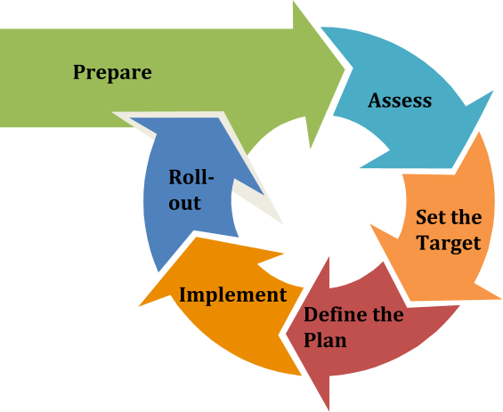
Methodology: Adaptable Approach
Notes:
The value of OWASP SAMM lies in providing a means to know where your organization is on its journey towards software assurance and understand what is recommended to move to a next level of maturity. OWASP SAMM does not insist that all organizations achieve maturity level 3 in every category. Indeed, you determine the target maturity level for each Security Practice that is the best fit for your organization and its needs. You should adapt these Practices and Activities to the needs of your organization.

Slide 73
Prepare
Purpose
Ensure a proper start of the project
Activities
Define the scope (uniform unit(s))
Identify stakeholders
Socialize – spread the word!
Notes:
Define the scope - Set the target of the effort: the entire enterprise, a particular application or project, a particular team.
Identify stakeholders - Ensure that important stakeholders are identified and well aligned to support the project.
Spread the word- Socialize the initiative to increase awareness.
Best Practices:
Pre-screen software development maturity to have realistic expectations
The smaller the scope, the easier the exercise
Resources:
Consider involving at least:
Executive Sponsor
Security Team
Developers
Architects
Business Owners
QA Testers
Managers

Slide 74
Assess
Purpose
Identify and understand the maturity of
the 15 practices for the chosen scope
Activities
Evaluate current practices
Determine maturity level
Notes:
Activities
Evaluate current practices - Organize interviews with relevant stakeholders to understand the current state of practices within your organization. You could evaluate this yourself if you understand the organization sufficiently enough. SAMM provides lightweight and detailed assessments, where the latter is an evidence-based evaluation, use the detailed one only if you want to have absolute certainty about the scores.
Determine maturity level - Based on the outcome of the previous activity, determine for each security practice the maturity level according to the SAMM maturity scoring system. Activities are scored by a multiple choice system and are averaged out for the security practice area, then added together to determine the overall score.
Best practices
Ensure consistent assessment for different stakeholders and teams by using the same questions and interviewer
Consider using different formats to gather data e.g., workshops vs. interviews
Ensure interviewees understand the particularities of activities
Understand which activities are not applicable to the organization, and take this into account in the overall scoring
Anticipate/document whether you plan to award partial credit, or just document various judgment calls
Repeat questions to several people to improve the assessment quality
Consider making interviews anonymous to ensure honesty
Don’t take questions too literally

Slide 75
Set the Target
Purpose
Develop a target score to guide you in future improvements
Activities
Define the target
Estimate overall impact
Notes:
Leverage the Roadmap worksheet in the SAMM Toolbox to help calculate maturity score improvements based on future answers
Define the target - Set or update the target by identifying which activities your organization should implement ideally. Typically, this will include more lower-level than higher-level activities. Predefined roadmap templates can be used as a source for inspiration. Ensure that the total set of selected activities makes sense, and take into account dependencies between activities.
Estimate overall impact - Estimate the impact of the chosen target on the organization. Try to express in budgetary arguments.
Best practices
Take into account the organization’s risk profile
Respect dependencies between activities
As a rough measure, the overall impact of a software assurance effort is estimated at 5 % to 10% of the total development cost

Slide 76
Define the Plan
Purpose
Define or update the plan to take you to the next level
Activities
Determine change schedule
Develop/update the roadmap plan
Notes:
Determine change schedule - Choose a realistic change strategy in terms of number and duration of phases. A typical roadmap consists of 4 to 6 phases for 3 to 12 months.
Develop/update the roadmap plan - Distribute the implementation of additional activities over the different roadmap phases, taking into account the effort required to implement them. Try to balance the implementation effort over the different periods, and take dependencies between activities into account.
Best practices
Identify activities that can be completed quickly and successfully early in the project
Start with awareness / training
Adapt to coming release cycles / key projects

Slide 77
Implement
Objective
Work the plan
Activities
Implement activities
Notes:
Implement activities - Implement all activities that are part of this period. Consider their impact on processes, people, knowledge, and tools. The SAMM model contains prescriptive advice on how to do this. OWASP projects may help to facilitate this.
Best practices
Treat legacy software separately. Do not mandate migration unless really important.
Avoid operational bottlenecks, particularly for the security team

Slide 78
Roll-Out
Objective
Ensure improvements are available and effectively used
Activities
Evangelize improvements
Measure effectiveness
Notes:
Evangelize improvements - Make the steps and improvements visible for everyone involved by organizing trainings and communicating with management stakeholders.
Measure effectiveness - Measure the adoption and effectiveness of implemented improvements by analyzing usage and impact.
Best practices
Categorize applications according to their impact on the organization. Focus on high-impact applications.
Use team champions to spread new activities throughout the organization.

Slide 79
Part Three
Applying OWASP SAMM
Methodology
Establishing Assessment Scope
Assessing Governance
Assessing Design
Assessing Implementation
Assessing Verification
Assessing Operations
Setting Improvement Targets

Slide 80
Establishing Assessment Scope
Scope based on Organization structure:
Organization wide
Selected Business Units/Center of Excellence
Development Groups (internal, supplier)
IT infrastructure Groups (hosting internal, cloud)
Scope based on Application risk profile:
High, Medium, Low based on risk: e.g. Internet facing, transactional, etc.
Data Classification level: e.g. Confidential, sensitive, public
Notes:
Link to the organisational context:
Specific Business Case (ROI)
Organisation objectives / risk profile
Data classification: PII, proprietary/trade secrets,

Slide 81
Part Three
Applying OWASP SAMM
Methodology
Establishing Assessment Scope
Assessing Governance
Assessing Design
Assessing Implementation
Assessing Verification
Assessing Operations
Setting Improvement Targets

Slide 82
Governance Business Function
Governance
Design
Implementation
Verification
Operations
Strategy &
Metrics
Threat
Assessment
Secure Build
Architecture Assessment
Incident Management
Create & promote
Measure & improve
App risk profile
Threat model
Build process
Dependencies
Architecture validation
Architecture compliance
Incident detection
Incident response
Policy & Compliance
Security Requirements
Secure Deployment
Requirements-
driven Testing
Environment Management
Policy & standards
Compliance Mgmt
Software reqmts
Supplier security
Deployment process
Secret mgmt
Control verification
Misuse/abuse testing
Config hardening
Patch & update
Education & Guidance
Secure Architecture
Defect Management
Security Testing
Operational Management
Security Architecture
Training & awareness
Org & culture
Architecture design
Technology mgmt
Defect tracking
Metrics & feedback
Scalable baseline
Deep understanding
Data protection
Legacy mgmt
Stream A
Stream B
Stream A
Stream B
Stream A
Stream B
Stream A
Stream B
Stream A
Stream B
Notes:
Measure things besides security bugs and vulnerabilities!
Re-write policies and controls as test scripts or runbooks
Consider product champions as well as security champions

Slide 83
Strategy & Metrics
Goal is to build an efficient and effective plan for realizing your software security objectives within your organization
Forms the basis of your secure software activities by building an overall plan.
Driver for all other OWASP SAMM practices
Characteristics:
Measurable
Aligned with business risk
Continuous improvement

Slide 84
Strategy & Metrics
Do you understand the enterprise-wide risk appetite for your applications?
No
Yes, it covers general risks
Yes, it covers organization-specific risks
Yes, it covers risks and opportunities
You capture the risk appetite of your organization’s executive leadership
The organization’s leadership vet and approve the set of risks
You identify the main business and technical threats to your assets and data
You document risks and store them in an accessible location

Slide 85
Policy & Compliance
Goal is to understand and adhere to legal and regulatory requirements
Internal standards as well as 3rd party requirements
Both Security and Privacy are critical
Technical standards become more important
They are an important driver for software security requirements
Often a very informal practice in organisations

Slide 86
Policy & Compliance
Do you have and apply a common set of policies and standards throughout your organization?
No
Yes, for some applications
Yes, for at least half of the applications
Yes, for most or all of the applications
You have adapted existing standards appropriate for the organization’s industry to account for domain- specific considerations
Your standards are aligned with your policies and incorporate technology-specific implementation guidance

Slide 87
Education & Guidance
Goal is to disseminate security-oriented information to all stakeholders involved in the software development lifecycle
Security to be integrated in organisation training curriculum
An ounce of effort is not sufficient
Teach teams to be security self-sufficient
Work on the organisational habits via security culture
Important element of a successful software assurance project

Slide 88
Education & Guidance
Do you require employees involved with application development to take SDLC training?
No
Yes, some of them
Yes, at least half of them
Yes, most or all of them
Training is repeatable, consistent, and available to all stakeholders
Training includes the latest OWASP Top 10
Training requires a sign-off or an acknowledgement from attendees
Training is updated annually
Training is required during onboarding

Slide 89
Part Three
Applying OWASP SAMM
Methodology
Establishing Assessment Scope
Assessing Governance
Assessing Design
Assessing Implementation
Assessing Verification
Assessing Operations
Setting Improvement Targets

Slide 90
Design Business Function
Governance
Design
Implementation
Verification
Operations
Strategy &
Metrics
Threat
Assessment
Secure Build
Architecture Assessment
Incident Management
Create & promote
Measure & improve
App risk profile
Threat model
Build process
Dependencies
Architecture validation
Architecture compliance
Incident detection
Incident response
Policy & Compliance
Security Requirements
Secure Deployment
Requirements-
driven Testing
Environment Management
Policy & standards
Compliance Mgmt
Software reqmts
Supplier security
Deployment process
Secret mgmt
Control verification
Misuse/abuse testing
Config hardening
Patch & update
Education & Guidance
Secure Architecture
Defect Management
Security Testing
Operational Management
Security Architecture
Training & awareness
Org & culture
Architecture design
Technology mgmt
Defect tracking
Metrics & feedback
Scalable baseline
Deep understanding
Data protection
Legacy mgmt
Stream A
Stream B
Stream A
Stream B
Stream A
Stream B
Stream A
Stream B
Stream A
Stream B
Notes:
Build granular application risk profiles
Make requirements transparent and accessible
Develop and document architectural standards

Slide 91
Threat Assessment
Analyze the risks of the application
from a business perspective, via risk profiles
from a technical perspective, via threat modeling
Threat modeling is where “the magic” kicks in determining:
What are we building?
What could go wrong?
How will we prevent it?
Did what we do work?
Your imagination is the limit

Slide 92
Threat Assessment
An agreed-upon risk classification exists
The application team understands the risk classification
The risk classification covers critical aspects of business risks the organization is facing
The organization has an inventory for the applications in scope
Do you classify applications according to business risk based on a simple and predefined set of questions?
No
Yes, some of them
Yes, at least half of them
Yes, most or all of them

Slide 93
Security Requirements
Goal is to make security specification more explicit
Turn security into a positively-spaced problem
Security requirements sources:
Compliance
Standards
Functionality
Quality
Requirements should be specified in a S.M.A.R.T. way
Also look into how suppliers approach to security
Notes:
Specific
Measurable
Achievable
Realistic
Timely

Slide 94
Security Requirements
Do project teams specify security requirements during development?
No
Yes, for some applications
Yes, for at least half of the applications
Yes, for most or all of the applications
Teams derive security requirements from functional requirements and customer or organization concerns
Security requirements are specific, measurable, and reasonable
Security requirements are in line with the organizational baseline

Slide 95
Secure Architecture
Secure Architecture is a key practice for security. Poor decisions at this step can have major impact, and are often difficult (and potentially costly) to fix.
Software Architecture components
Ensure that the architecture contains proper elements to meet the security requirements
Supporting Technology
Verify that development stacks, deployment tools and other supporting technology are in-line with security expectations

Slide 96
Secure Architecture
You have an agreed upon checklist of security principles
You store your checklist in an accessible location
Relevant stakeholders understand security principles
Do teams use security principles during design?
No
Yes, for some applications
Yes, for at least half of the applications
Yes, for most or all of the applications

Slide 97
Part Three
Applying OWASP SAMM
Methodology
Establishing Assessment Scope
Assessing Governance
Assessing Design
Assessing Implementation
Assessing Verification
Assessing Operations
Setting Improvement Targets

Slide 98
Implementation Business Function
Governance
Design
Implementation
Verification
Operations
Strategy &
Metrics
Threat
Assessment
Secure Build
Architecture Assessment
Incident Management
Create & promote
Measure & improve
App risk profile
Threat model
Build process
Dependencies
Architecture validation
Architecture compliance
Incident detection
Incident response
Policy & Compliance
Security Requirements
Secure Deployment
Requirements-
driven Testing
Environment Management
Policy & standards
Compliance Mgmt
Software reqmts
Supplier security
Deployment process
Secret mgmt
Control verification
Misuse/abuse testing
Config hardening
Patch & update
Education & Guidance
Secure Architecture
Defect Management
Security Testing
Operational Management
Security Architecture
Training & awareness
Org & culture
Architecture design
Technology mgmt
Defect tracking
Metrics & feedback
Scalable baseline
Deep understanding
Data protection
Legacy mgmt
Stream A
Stream B
Stream A
Stream B
Stream A
Stream B
Stream A
Stream B
Stream A
Stream B
Notes:
Ensure all team members are familiar with securing the CI/CD pipeline
https://github.com/hysnsec/DevSecOps-Studio
Improve defect tracking to identify trends over time

Slide 99
Secure Build
Secure build focuses on using a reliable production process in order to generate secure software artifacts and to avoid issues being introduced during the process
An important part is the build process itself, where the goal is consistent, repeatable, and automated
A second part focuses on software dependencies or 3rd party libraries, aka supply chain security.

Slide 100
Secure Build
Is your full build process formally described?
No
Yes, for some applications
Yes, for at least half of the applications
Yes, for most or all of the applications
You have enough information to recreate the build processes
Your build documentation up to date
Your build documentation is stored in an accessible location
Produced artifact checksums are created during build to support later verification
You harden the tools that are used within the build process

Slide 101
Secure Deployment
One of the final stages in delivering secure software is ensuring the security and integrity of developed applications are not compromised during their deployment.
In the deployment process, appropriate protections are a repeatable deployment process, separation of duties, etc.
All secrets required for the software to run must be properly protected for deployment and during execution. Tools such as password vaults can help to achieve this.

Slide 102
Secure Deployment
No
Yes, for some applications
Yes, for at least half of the applications
Yes, for most or all of the applications
You have enough information to run the deployment processes
Your deployment documentation up to date
Your deployment documentation is accessible to relevant stakeholders
You ensure that only defined qualified personnel can trigger a deployment
You harden the tools that are used within the deployment process
Do you use repeatable deployment processes?

Slide 103
Defect Management
The Defect Management practice focuses on collecting, recording, and analysing software security defects and enriching them with information to drive metrics-based decisions.
It is a central funnel for all defects identified in other security practices.
A defect tracking solution helps the organization to keep track of identified problems, and to manage them in a controlled manner.
Analysis of defects supported by metrics can help to increase awareness and guide improvement programs in the organization.

Slide 104
Defect Management
You can easily get an overview of all security defects impacting one application
You have at least a rudimentary classification scheme in place
The process includes a strategy for handling false positives and duplicate entries
The defect management system covers defects from various sources and activities
Do you track all known security defects in accessible locations?
No
Yes, for some applications
Yes, for at least half of the applications
Yes, for most or all of the applications

Slide 105
Part Three
Applying OWASP SAMM
Methodology
Establishing Assessment Scope
Assessing Governance
Assessing Design
Assessing Implementation
Assessing Verification
Assessing Operations
Setting Improvement Targets

Slide 106
Verification Business Function
Governance
Design
Implementation
Verification
Operations
Strategy &
Metrics
Threat
Assessment
Secure Build
Architecture Assessment
Incident Management
Create & promote
Measure & improve
App risk profile
Threat model
Build process
Dependencies
Architecture validation
Architecture compliance
Incident detection
Incident response
Policy & Compliance
Security Requirements
Secure Deployment
Requirements-
driven Testing
Environment Management
Policy & standards
Compliance Mgmt
Software reqmts
Supplier security
Deployment process
Secret mgmt
Control verification
Misuse/abuse testing
Config hardening
Patch & update
Education & Guidance
Secure Architecture
Defect Management
Security Testing
Operational Management
Security Architecture
Training & awareness
Org & culture
Architecture design
Technology mgmt
Defect tracking
Metrics & feedback
Scalable baseline
Deep understanding
Data protection
Legacy mgmt
Stream A
Stream B
Stream A
Stream B
Stream A
Stream B
Stream A
Stream B
Stream A
Stream B
Notes:
Whenever possible automate architecture checks
Invest in tools to identify vulnerable code as it is written or committed
Balance automated and pen testing for effective and efficient results

Slide 107
Architecture Assessment
Verify whether the solution meets security and compliance requirements
Covers both software and supporting infrastructure
Rigorous inspection of data flows & security mechanisms

Slide 108
Architecture Assessment
Do you review the application architecture for key security objectives on an ad-hoc basis?
No
Yes, for some applications
Yes, for at least half of the applications
Yes, for most or all of the applications
You have an agreed upon model of the overall software architecture
You include components, interfaces, and integrations in the architecture model
You verify the correct provision of general security mechanisms
You log missing security controls as defects

Slide 109
Requirements-driven Testing
First perspective for testing: test the software according to the requirements
Conduct positive and negative security tests to verify that the software operates as specified.
From the known security requirements, identify and implement a set of security test cases to check the software for correct functionality.
Use abuse testing for an application to run concrete security tests that directly or indirectly exploit identified abuse scenarios.
Automate security testing (for each release) via security test automation and automated regression testing

Slide 110
Requirements-driven Testing
Security testing at least verifies the implementation of authentication, access control, input validation, encoding and escaping data, and encryption controls
Security testing executes whenever the application changes its use of the controls
Do you test applications for the correct functioning of standard security controls?
No
Yes, some of them
Yes, at least half of them
Yes, most or all of them

Slide 111
Security Testing
Second perspective for testing: test the software according to security best practices
SAST/DAST/IAST automated tooling
Manual testing for fine-grained verification
Detected defects will require validation, risk analysis & recommendations to fix

Slide 112
Security Testing
Do you scan applications with automated security testing tools?
No
Yes, some of them
Yes, at least half of them
Yes, most or all of them
You dynamically generate inputs for security tests using automated tools
You choose the security testing tools to fit the organization’s architecture and technology stack, and balance depth and accuracy of inspection with usability of findings to the organization

Slide 113
Part Three
Applying OWASP SAMM
Methodology
Establishing Assessment Scope
Assessing Governance
Assessing Design
Assessing Implementation
Assessing Verification
Assessing Operations
Setting Improvement Targets

Slide 114
Operations Business Function
Governance
Design
Implementation
Verification
Operations
Strategy &
Metrics
Threat
Assessment
Secure Build
Architecture Assessment
Incident Management
Create & promote
Measure & improve
App risk profile
Threat model
Build process
Dependencies
Architecture validation
Architecture compliance
Incident detection
Incident response
Policy & Compliance
Security Requirements
Secure Deployment
Requirements-
driven Testing
Environment Management
Policy & standards
Compliance Mgmt
Software reqmts
Supplier security
Deployment process
Secret mgmt
Control verification
Misuse/abuse testing
Config hardening
Patch & update
Education & Guidance
Secure Architecture
Defect Management
Security Testing
Operational Management
Security Architecture
Training & awareness
Org & culture
Architecture design
Technology mgmt
Defect tracking
Metrics & feedback
Scalable baseline
Deep understanding
Data protection
Legacy mgmt
Stream A
Stream B
Stream A
Stream B
Stream A
Stream B
Stream A
Stream B
Stream A
Stream B
Notes:
Prepare for security incidents one application at a time
Configuration hardening and patching may look different but are still necessary
Review test data routines regularly for accuracy

Slide 115
Incident Management
Prepare for WHEN, not IF!
Examples of a security incidents:
successful DoS (Denial of Service) attack against a cloud application
application user accessing private data of another one by abusing a security vulnerability
attacker modifying the application source code
Have a capability in place to detect potential incidents
Make sure you can respond to detected incidents
Use vulnerability metrics and root-cause analysis to improve SDLC

Slide 116
Incident Management
No
Yes, for some applications
Yes, for at least half of the applications
Yes, for most or all of the applications
You have a contact point for the creation of security incidents
You analyze data in accordance with the log data retention periods
The frequency of this analysis is aligned with the criticality of your applications
Do you analyze log data for security incidents periodically?

Slide 117
Environment Management
Application security transitions to operational modes. New security features and patches are continuously released until the technology stack you’re using becomes obsolete.
Pro-actively maintain the different technology components in the software environment by activating security features and removing unnecessary ones.
Install patches to ensure technology components can withstand known security attacks.

Slide 118
Environment Management
No
Yes, for some components
Yes, for at least half of the components
Yes, for most or all of the components
You have identified the key components in each technology stack used
You have an established configuration standard for each key component
Do you harden configurations for key components of your technology stacks?

Slide 119
Operational Management
This practice focuses on operational support activities required to maintain security throughout the product lifecycle.
Data must be sufficiently protected in its different forms and environments to ensure a correct operation of the application
Legacy management ensures there are no loose ends, often forgotten, in the organisation which may form an easy target to attackers.

Slide 120
Operational Management
Do you identify and patch vulnerable components?
No
Yes, for some components
Yes, for at least half of the components
Yes, for most or all of the components
You have an up-to-date list of components, including version information
You regularly review public sources for vulnerabilities related to your components

Slide 121
Part Three
Applying OWASP SAMM
Methodology
Establishing Assessment Scope
Assessing Governance
Assessing Design
Assessing Implementation
Assessing Verification
Assessing Operations
Setting Improvement Targets

Slide 122
Setting Improvement Targets
Roadmap templates can provide direction for targets
What type of company are you ?
Take into account the company’s risk appetite
Only include activities where you see added value for the company, even for lower levels
OWASP SAMM activities have dependencies – use them !
Think about links with other practices in the company e.g., training, release management, risk management,

Slide 123
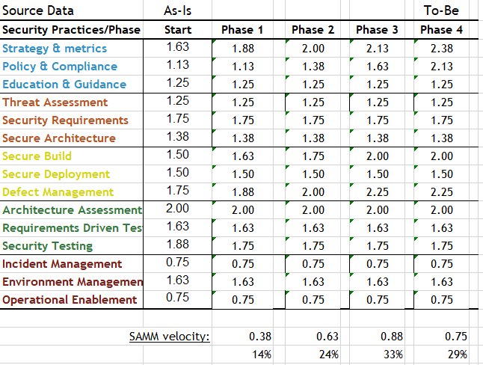
Sample Roadmap
Notes:
‹#›

Slide 124
Part Four
OWASP SAMM Best Practices
Choosing the Right Starting Points
Metrics and Management
Achieving Security by Design
Critical Success Factors

Slide 125

Complicating Factors, Anyone ?
Different development teams
Different technology stacks
Business-IT alignment issues
Outsourced development

Slide 126

Start Where You Are
Organizational Context
Be aware of assumptions about security, and
work to alter them
Realistic Goals
Focus on reasonable security outcomes
Manageable Scope
Constraints:
budget, timing, resources

Slide 127
What’s Your Company Maturity ?
In terms of IT Strategy and application Landscape
In terms of Software Development practices
Analysis, Design, Implementation, Testing, Release, Maintenance
Structured vs. ad-hoc development
In terms of ITSM practices
Configuration, Change, Release, Vulnerability-Management
Current Company Maturity
≈
Feasibility of SDLC Program

Slide 128
Importance of Business Case
If you want your security posture to improve, management buy-in is crucial!
You will need a business case to convince them
Typical arguments:
Improved security quality
Better cost efficiency
Compliance
Risk management
Customer satisfaction
Reputation management

Slide 129
Entry Points
Pick the weak spots that can demonstrate short-term ROI
Typical examples
Awareness training
Coding Guidelines
External Pentesting
Success will help you in continuing your effort

Slide 130
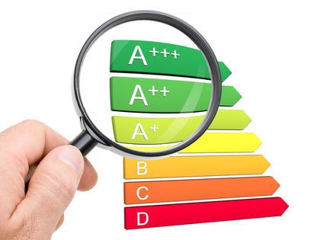
Application Categorization
Use risk profiles to rationalize security effort and for prioritization
Data Classification
Integrations & dependencies
Use this to rationalize security effort (according to the application risk)

Slide 131

Communication & Support
Critical success factor
Spreading the message to a broad audience
Setup a secure applications portal !
Regular status updates towards management

Slide 132
Part Four
OWASP SAMM Best Practices:
Choosing the Right Starting Points
Metrics and Management
Achieving Security by Design
Critical Success Factors

Slide 133
Metrics and Management
Success metrics are possible in SAMM for:
5 Business Functions
15 Security Practices
30 Streams
90 Activities
Leveraging a phased roadmap, there is plenty of time-based data to report progress, ROI, and success!

Slide 134
Metrics and Management
Application Metrics
number of applications
number of components by category of origin (COTS, GOTS, OSS, and so forth)
counts of defects, weaknesses, or vulnerabilities
effort fixing defects, weaknesses, and vulnerabilities
effort applying or implementing security-related tools and techniques
mean time to remediation
ratio of defects or vulnerabilities found in production vs. test
potential severity of the defect (CVSS, DREAD, etc.)

Slide 135
Metrics and Management
Process Metrics
techniques used during each development activity
effort fixing defects, weaknesses, and vulnerabilities
effort applying security-related tools and techniques
test effort and duration
rate of weakness (or defect) removal

Slide 136
Responsibilities
Core Security team
Support vs. Responsible role
Security Satellite
Analysts
Architects
Developers
Operations
Management
Formalized RACI is possible but will be a challenge

Slide 137
Part Four
OWASP SAMM Best Practices:
Choosing the Right Starting Points
Metrics and Management
Achieving Security by Design
Critical Success Factors

Slide 138
The Power of Default Security
Implement development frameworks that are secure by default
Minimizes work for developers
Will lower number of vulnerabilities
Notes:
Security improvements must be aligned to the company practices.
Security typically better aligns to waterfall-like processes, however can be used in agile methods as well:
• Organisation of activities is different
• Setup of activities needs to be adapted to the techniques used in the concrete process (e.g., abuser stories for threat modelling)

Slide 139
Part Four
OWASP SAMM Best Practices
Choosing the Right Starting Points
Monitoring and Metrics
Achieving Security by Default
Critical Success Factors

Slide 140
Critical Success Factors
Get initiative buy-in from stakeholders
Adopt a risk-based approach
Awareness / education is the foundation
Integrate & automate security in your development, acquisition and deployment processes
Measure: Provide management visibility

Slide 141
SDLC Cornerstones - Recap
People
Roles & Responsibilities
Risk
Training
Process
Activities
Deliverables
Control Gates
Knowledge
Standards & Guidelines
Compliance
Transfer methods
Tools & Components
Development support
Assessment tools
Management tools
Notes:
SDLC is the framework for most of this session
No model is perfect, but they provide good guidance
Find balance for all cornerstones
Risk Management is key for rationalizing effort
Beware the big bang
‹#›

Slide 142
Conclusions
Developing secure software is increasingly complex
OWASP SAMM 2.0 is a global maturity foundation for software assurance, in line with current trends and practices
Applying OWASP SAMM:
Assessment
Roadmap
(Continuous) Implementation
Be ready to face the organisational challenges that will pop up during the journey!

Slide 143
Current Roadmap
2020
Iterative releases
v2.1
v2.2
Agile/Devops guidance
Roadshows/Trainings

Slide 144
Looking forward
OWASP Project Integration
Online assessments integrated with benchmark data
User community contributions
Support for regulations
OWASP SAMM user summits
Translations!

Slide 145
Support OWASP SAMM
Software powers the world, but insecure software threatens safety, trust, and economic growth.

Slide 146
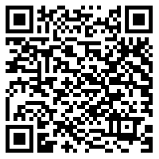
Get Involved
Website: https://owaspsamm.org
Github: https://github.com/OWASP/samm/
Slack: OWASP - #project-samm
Use it and donate (feed)back!
Donate time!
Sponsor SAMM:
https://owasp.org/www-project-samm/
SAMM Newsletter

Slide 147

Questions?
Feedback?

Slide 148
Thank you!

